Slide 1
REPORT ANALYSIS
TEAM MEMBERS:
B PAVANI
JANAKI SRI RAM
SAGAR
VAMSHI KRISHNA
PRADEEP
PRAVEEN
SAI KIRAN
NAVYA
MUHIB KHAN

Slide 2
PART 1 TASK RESPONSIBILITIES

Slide 3
TASK1
How much is spent for each category (Pivot Table)
Visually represent the amount spent against each category is what percentage of the total expense amount (Pivot Chart)

Slide 4
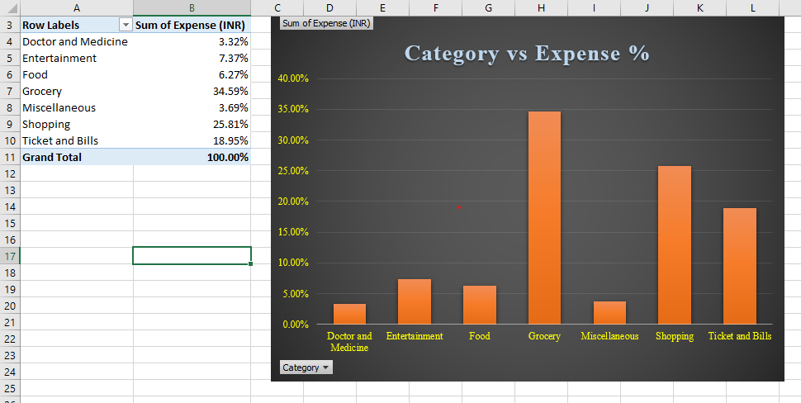

Slide 5
TASK 2
How much is spent on different items of each category (Pivot Table)
Visually represent the amount spent on different items of Entertainment and Tickets and bills category (Pivot Chart)

Slide 6
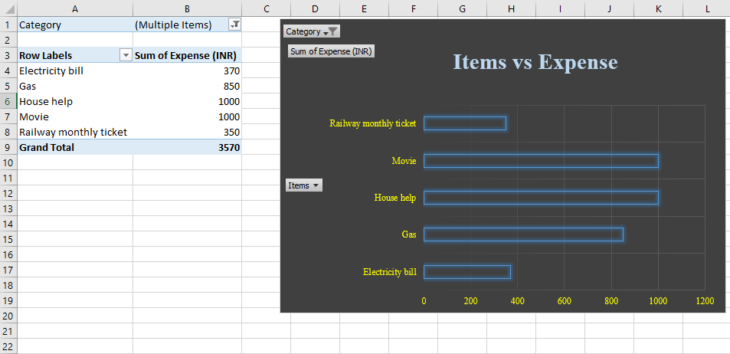

Slide 7
TASK 3
How many times money has been spent against different items of each category (Pivot Table)
Filter the data to display the data for Grocery items and Shopping items

Slide 8
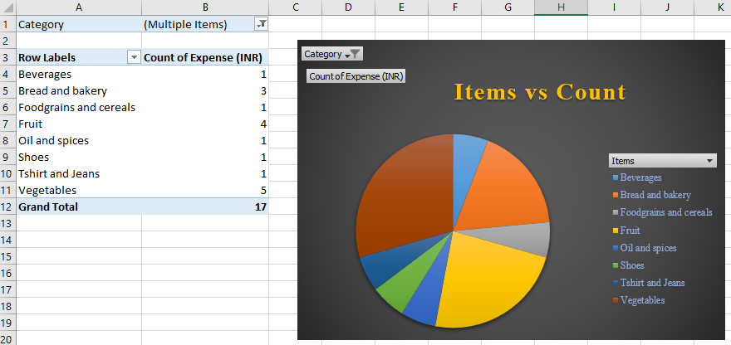

Slide 9
TASK 4
What amount is spent on each item of the categories with highest and 2nd highest expense amount (Pivot Table)
Visually represent the data with data bars (Conditional formatting)

Slide 10
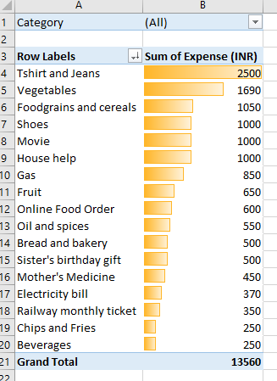

Slide 11
PART 2 TASK RESPONSIBILITIES

Slide 12
TASK1
Month-wise trend of expenses (Pivot table and chart)
Find out the month Nitin spent the most

Slide 13
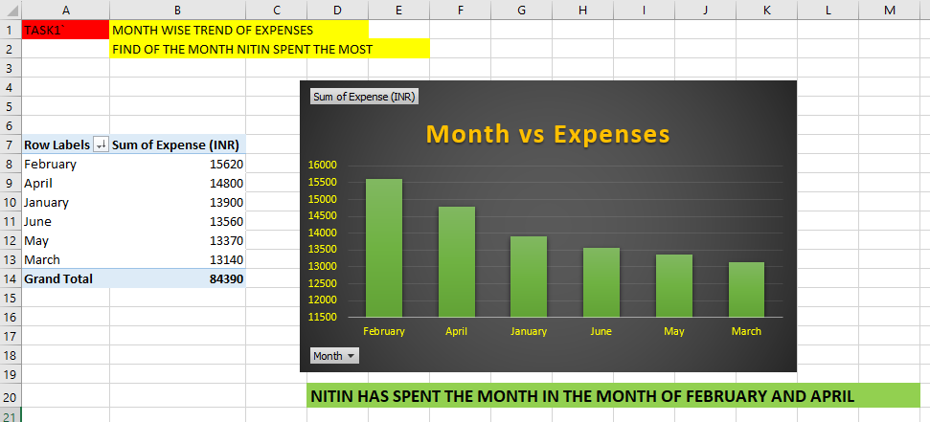

Slide 14
TASK 2
Category wise expenses (Pivot table)
Visually represent it with data bars to display categories with the highest and lowest expense amount

Slide 15
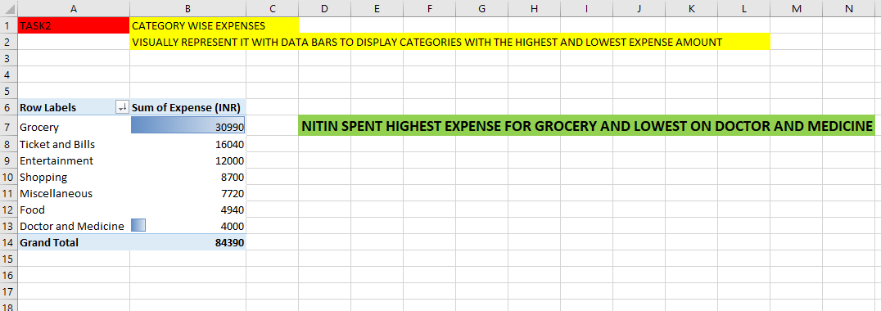

Slide 16
TASK 3
Month-wise expense of each category (Pivot table)
Find out 2 categories with higher expenses for each of the 6 months

Slide 17
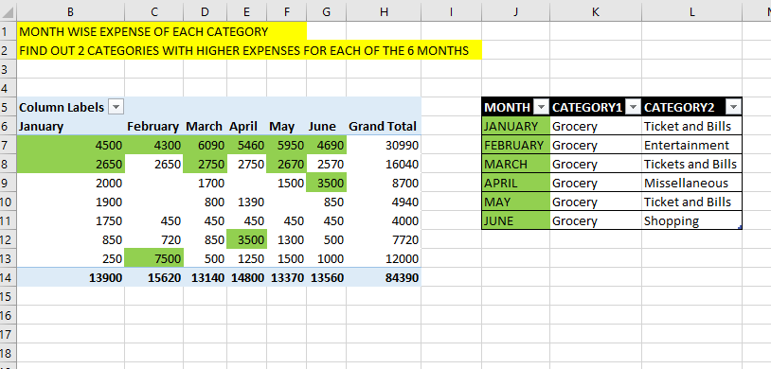

Slide 18
TASK 4
How much is spent in each month against different items of Entertainment, Food and Shopping categories (Pivot table)
Find out which months have the highest amount spent for movies and dining out

Slide 19
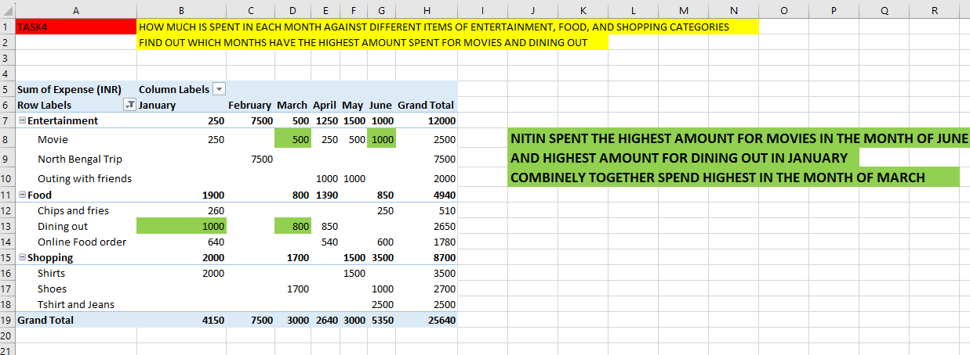

Slide 20
TASK 5
Decide on the essential and less essential items and analyse the expenses
Recommend how can Nitin increase his savings

Slide 21
Essential Items:
Grocery
Foodgrains and cereals, Oil and spices, Vegetables, Fruit, Bread and bakery
Doctor and Medicine
Mother's Medicine
Ticket and Bills
Railway monthly ticket, House help, Electricity bill, Gas

Slide 22
Non-Essential Items:
Entertainment
Movie
Food
Online Food Order, Chips and Fries
Shopping
Shoes, Tshirt and Jeans
Miscellaneous
Sister's birthday gift

Slide 23
Recommendations to Increase Savings:
Reduce Entertainment Expenses
Cut Down on Non-Essential Shopping
Avoid Unnecessary Miscellaneous Expenses
Optimize Grocery Shopping
Reduce Utility Bills
Use Public Transportation or More Cost-Effective Options
Create and Stick to a Monthly Budget
Seek Discounts and Coupons for Purchases
Plan Meals to Avoid Food Waste
Monitor and Control Impulse Purchases
Set Savings Goals and Track Progress

Slide 24
THANK YOU

